Slide 1

N-Tier Architecture
Michael (Mike) Zak
ALLPPT.com _ Free PowerPoint Templates, Diagrams and Charts

Slide 2
N-Tier Architecture
Agenda
Data-Driven Applications
Monolithic Design
The Layers of N-Tier Architecture
Model
Business Logic
Data Access
Presentation
Communication
Common Paradigms
Live Demo: Horse Betting

Slide 3

N-Tier Architecture
Data-Driven Applications
Most Applications are Driven By Data:
Resource Management
Online Shops
Search Engines
Auto-Pilot Module of a Drone

Slide 4

N-Tier Architecture
Data-Driven Applications
Some Things in Common:
Store and Retrieve Data
Process Data
Present Data

Slide 5


N-Tier Architecture
Monolithic Architecture
Throw Everything Into a Single App
In .NET world = One project
Common in Older Web-Frameworks
Classic ASP/ASP.NET
PHP

Slide 6
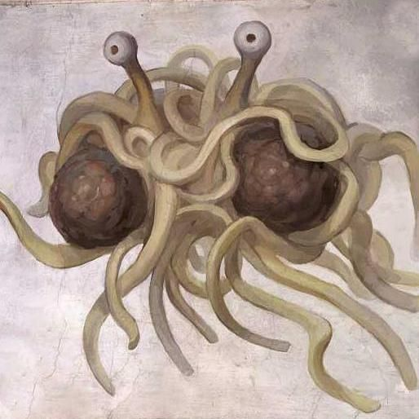
N-Tier Architecture
Monolithic Architecture
Pros:
Quick ‘n Dirty
Code as you Go
Cons:
Hard to Maintain
Hard to Change
Impossible to Compartmentalize
Quickly Becomes

Slide 7
N-Tier Architecture
Layers of N-Tier Architecture
Model
Presentation
Business Logic
Data Access

Slide 8
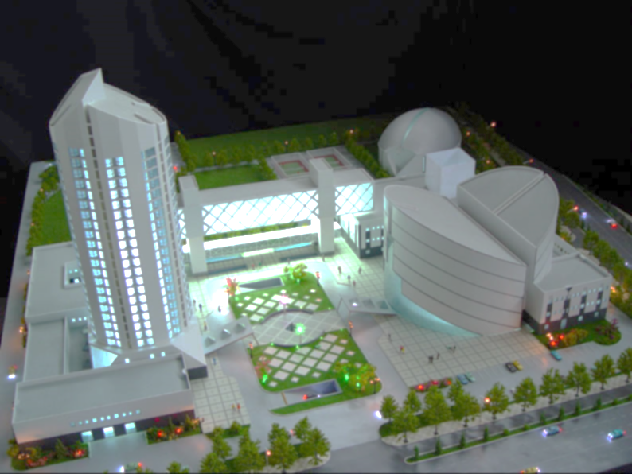
N-Tier Architecture
Model
Describes Your Data
Contract
POCO – Plain Old CLR Object
The Only Part Shared By All Layers

Slide 9

N-Tier Architecture
Data Access
How Data is Acquired and Stored?
Can Be:
Relational (SQL) Database
ADO.NET
ORM: Entity Framework / Nhibernate
NoSQL: MongoDB, Redis, etc.
Plain files: XML, JSON, etc.
APIs
Sensors
Etc.

Slide 10

N-Tier Architecture
Business Logic
What Happens to the Data?
Any Computation Including:
Calculation
Transformation
Aggregation
Classification
Etc.

Slide 11
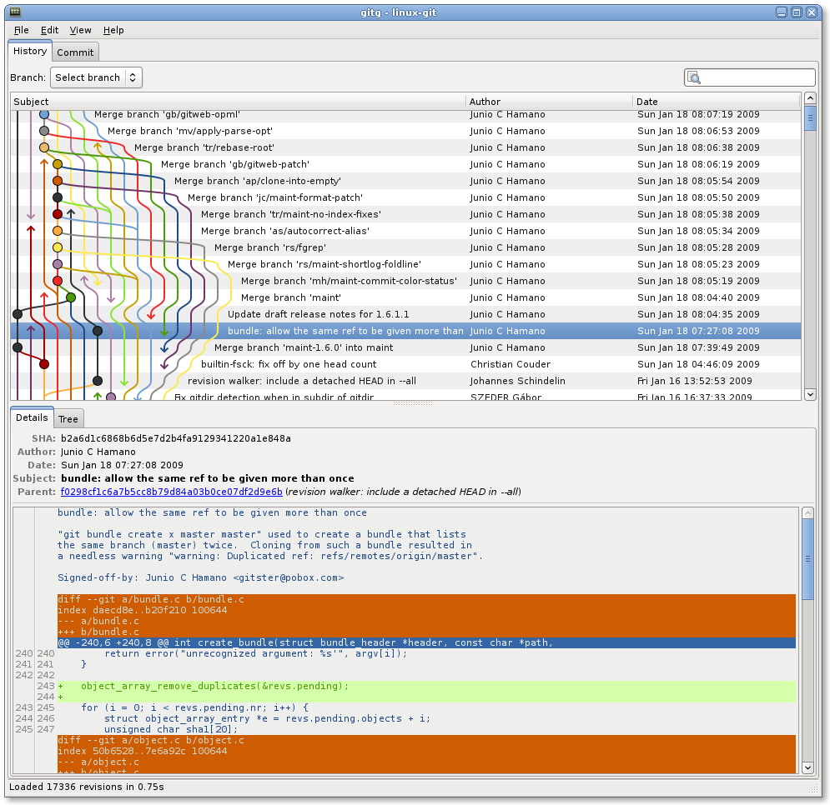
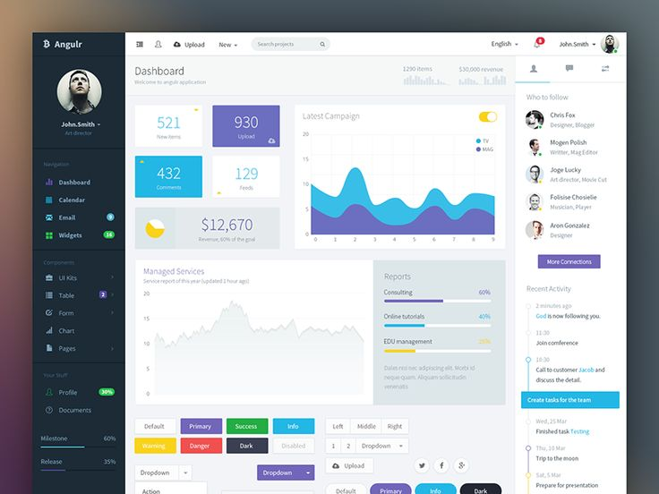
N-Tier Architecture
Presentation
How Data is Presented?
Could Be:
Website
Desktop Application
WinForms
WPF
Mobile App
API

Slide 12
N-Tier Architecture
N-Tier Architecture
Pros:
Natural Separation Between Layers
Each Part Interchangeable
Separation Of Development Between Developers or Teams
Everything Where it’s Expected to Be
Cons:
Initially Slower Development
Sometimes Hard to Do

Slide 13

N-Tier Architecture
A Word About Communication
Layers Could be On Same Machine…
… Or Not
Layers Communicate However Required or Possible:
DLL References
SOAP/RESTful API
Any Other Net Protocol:
Websockets
Pub/Sub: MQTT, AMQP
TCP or UDP

Slide 14
N-Tier Architecture
Several Paradigms
MVC
Controller is both:
Data Access
Business Logic
Great for Small/Medium Web Applications
MVVM
Separates Model to:
Model (Data Access, Business Logic)
ViewModel
Works Well For Desktop/Mobile Apps

Slide 15
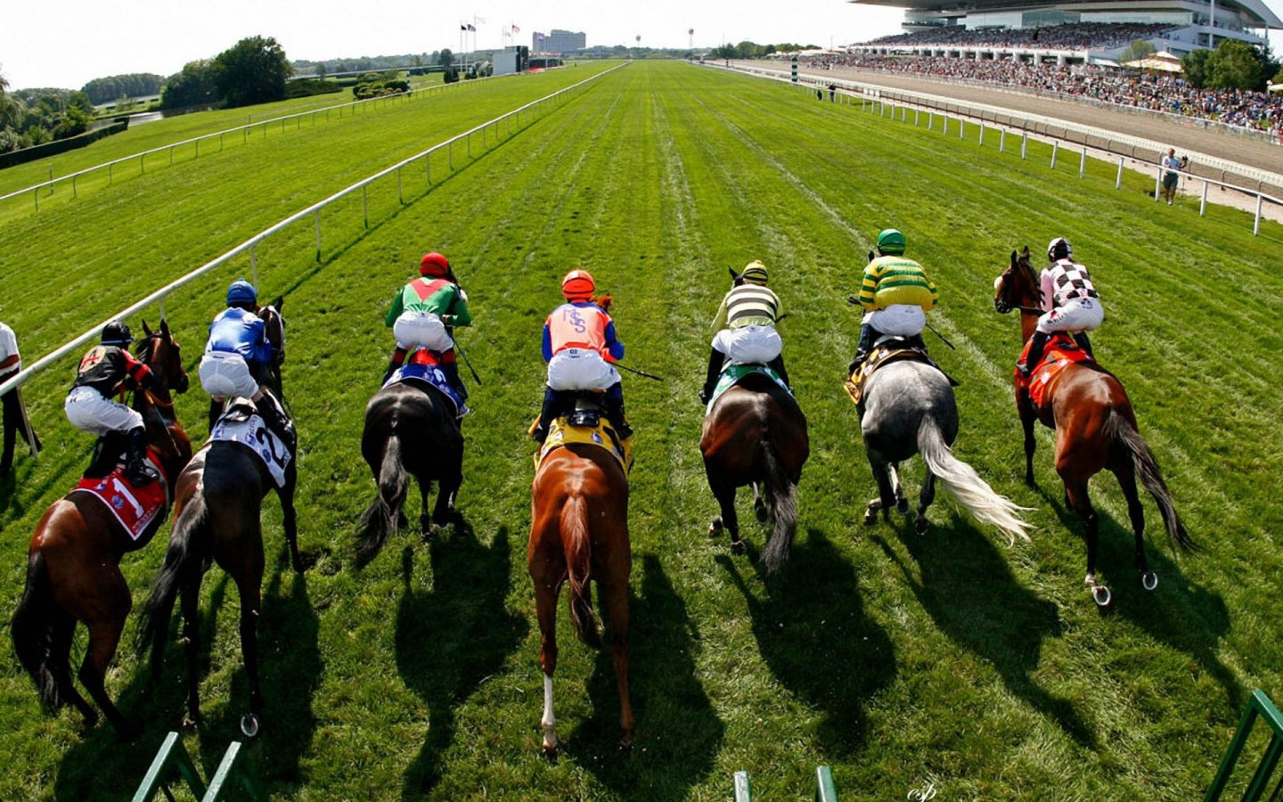
Demo
Horse Betting

Slide 16
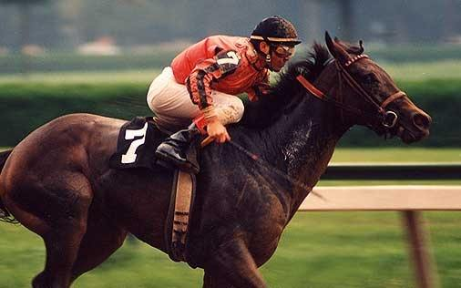
Horse Betting
Model
Rider:
Control
Fitness
Weight
Horse
Horse:
Speed
Endurance
Health
Race:
2 Riders
Bet:
Rider
Bidder
Amount

Slide 17
Horse Betting
Business Logic
Rider Score:
Control + Fitness + (99 – Weight)
Horse Score:
Speed + Endurance + Health
Luck:
Random Number Between 0 and 1
Wins Whoever Has the Highest:
(Rider Score + Horse Score) * Luck

Slide 18
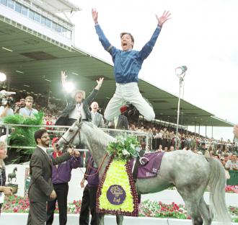
Horse Betting
Business Logic
Place Bets Before Races
Race Odds:
Rider1 Score / Rider2 Score
If Your Rider Wins You Get:
Bid Amount * (1 + Odds)

Slide 19

Horse Betting
First Iteration
Data Access:
JSON Files
Presentation:
Console Application

Slide 20

Horse Betting
Second Iteration
Data Access:
Entity Framework
Presentation:
WPF

